Slide 1
Marketing Management

Slide 2
Meaning of marketing
Marketing is a total system of business activities which are designed to plan a product, to determine its price and to distribute goods which can satisfy wants of the consumers.

Slide 3
Meaning of marketing management
Marketing management is the activity of producing goods or services from producers to customers.
Marketing management is such a process which decides the necessity of customers. It aims at creating demand for goods or services.
Main elements of marketing management are goods, services, physical distribution policy, price policy, increase in sale, packaging etc.

Slide 4
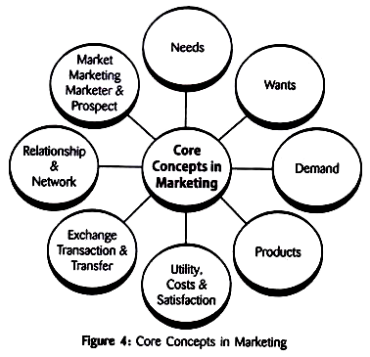
Core concept of marketing

Slide 5
Marketing MIX(4P)
To launch a product in the market successfully and to maintain its importance in the market, a number of policies that are adopted by a producer is called marketing mix,
Marketing mix helps in attaining the marketing objectives of a firm. The 4 Ps are
Product
Price
Place
Promotion

Slide 6
Product
Product can be goods or services which can satisfy the want of a consumer.
Product is the starting point of marketing which can satisfy the want of a consumer. Hence, product is base for marketing.
The decision regarding development of new product or existing product includes appearance, color, size, shape, weight, print, packing, guarantee of work, variety of product, after sales services etc.

Slide 7
Price
Price refers to the value paid by the consumer which is generally depicted in the form of money.
In modern times, a customer expects availability of better quality of goods at a reasonable price,
The price decision includes sales policy, credit policy, discount policy, wholesale or retail price etc.

Slide 8
Place/Distribution
Distribution mix includes decision regarding various way of selling like direct selling, through the wholesaler, retailer or agents as well as problems related to transportation etc.
It depends on the size and scope of a business.

Slide 9
Promotion
Promotion aims at remarkable increase in sale. It includes the matters like advertisement, publicity, selling through salesmen ways and means to attract customers.
Though promotion mix is expensive, it leads to increase in sale, which results into higher profitability.

Slide 10
Four Ps
Source: Philip Kotler et al, Marketing Management, 14th Edition, Page No. 23

Slide 11
STP
Segmenting, targeting and positioning a three-step model that examines your products or services as well as the way you communicate their benefits to specific customer segments.
In a nutshell, the STP marketing model means you segment your market, target select customer segments with marketing campaigns tailored to their preferences, and adjust your positioning according to their desires and expectations.

Slide 12
STP marketing is effective because it focuses on breaking your customer base into smaller groups, allowing you to develop very specific marketing strategies to reach and engage each target market.
STP marketing represents a shift from product-focused marketing to customer-focused marketing.

Slide 13
Segmentation
The first step of the STP marketing model is the segmentation stage. The main goal here is to create various customer segments based on specific criteria and traits that you choose.
Geographic segmentation: Diving your audience based on country, region, state etc.
Demographic segmentation: Dividing your audience based on age, gender, education level, occupation, gender, etc.
Behavioral segmentation: Dividing your audience based on how they interact with your business: What they buy, how often they buy, what they browse, etc.
Psychographic segmentation: Dividing your audience based on “who” your potential customer is: Lifestyle, hobbies, activities, opinions, etc.

Slide 14
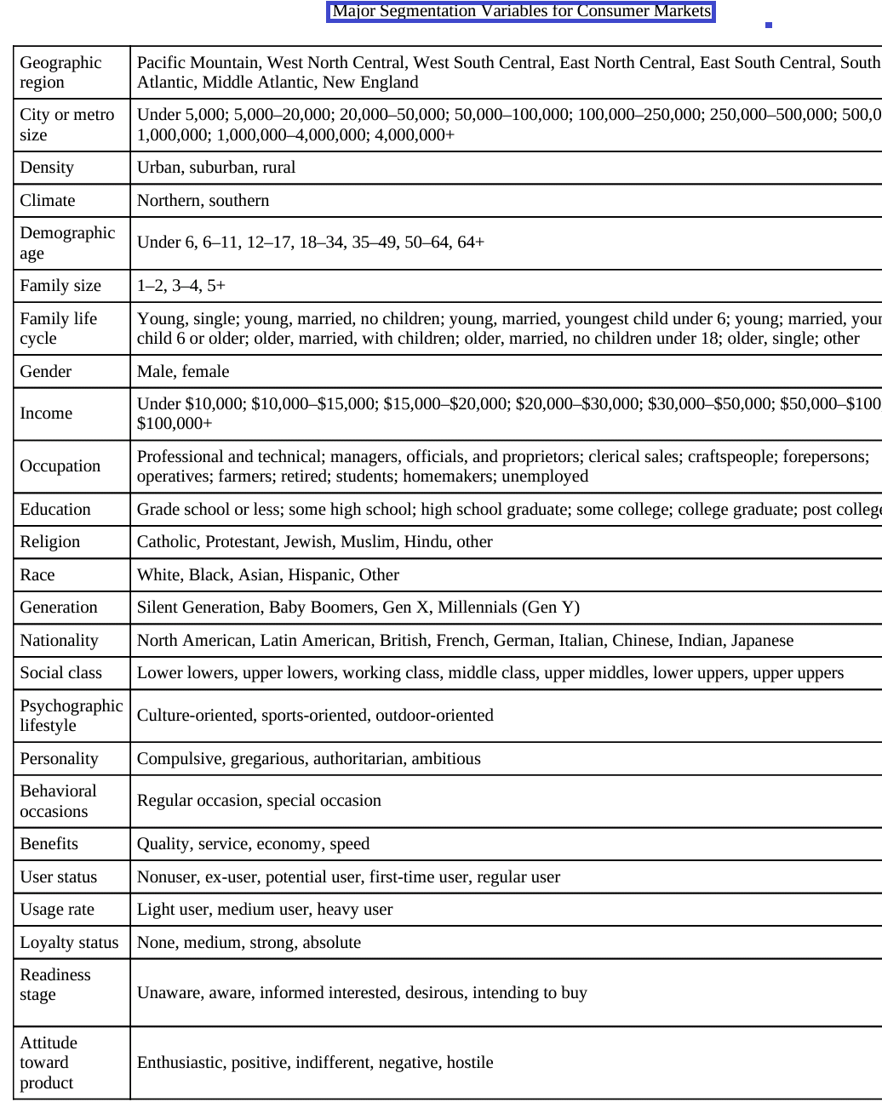

Slide 15
Bases for Segmenting Business market:
Industrial customers tend to be fewer in number and purchase larger quantities. Many of the consumer market segmentation variables can be applied to industrial markets. Industrial markets might be segmented on characteristics such as:
Location
Company type
Behavioral characteristics

Slide 16
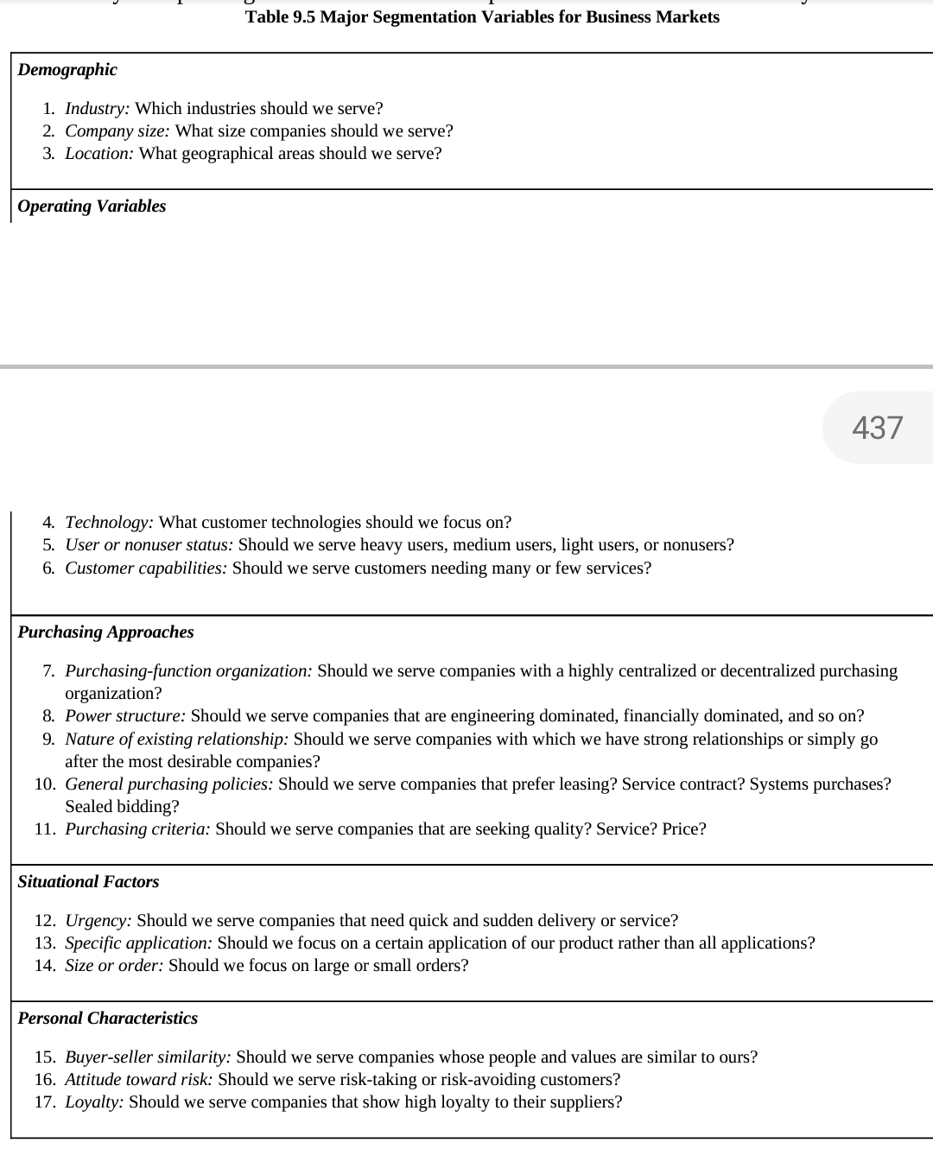
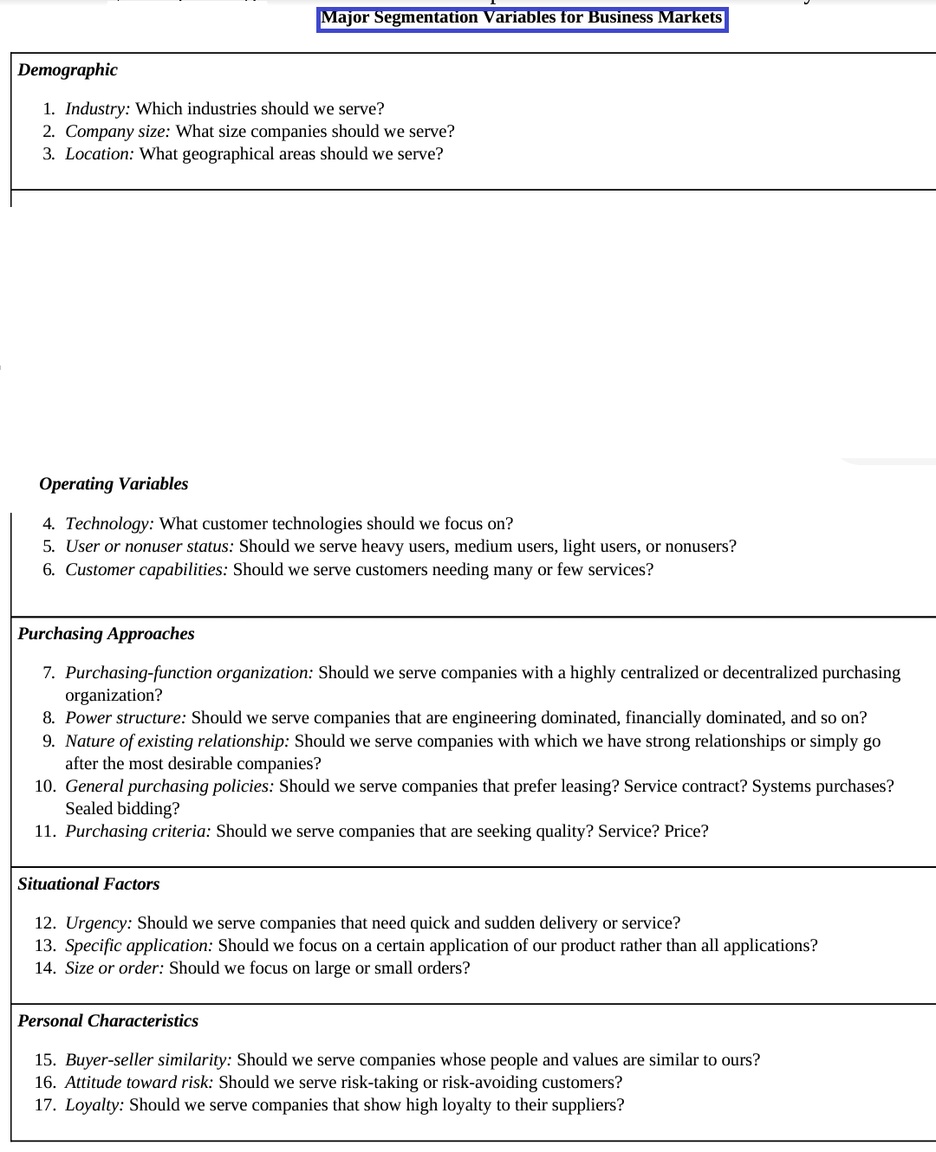

Slide 17
Targeting
Main goal here is to look at the segments you have created before and determine which of those segments are most likely to generate desired conversions
Size: Consider how large your segment is as well as its future growth potential.
Profitability: Consider which of your segments are willing to spend the most money on your product or service. Determine the lifetime value of customers in each segment and compare.
Reachability: Consider how easy or difficult it will be for you to reach each segment with your marketing efforts.

Slide 18
Targeting:
Target Marketing involves breaking a market into segments and then concentrating your marketing efforts on one or a few key segments. Target marketing can be the key to a small business’s success.
 | P1 | P2 | P3
M1
M2
M3

Slide 19
A company cannot concentrate on all the segments. The segment which company wants to serve is called target market.
Target Market strategies:
Single segment concentrated strategy (one product, one market)
Selective specialization (different products for different markets)
Product specialization (one product for all market)
Market specialization (all product for one market)
Full market coverage (all product for all market)

Slide 20
Positioning
The final step in this framework is positioning, which allows you to set your product or services apart from the competition in the minds of your target audience.
PERCEPTION
Symbolic positioning: Enhance the self-image, belongingness, or even ego of your customers. The luxury car industry is a great example of this – they serve the same purpose as any other car but they also boost their customer’s self-esteem and image.
Functional positioning: Solve your customer’s problem and provide them with genuine benefits.

Slide 21
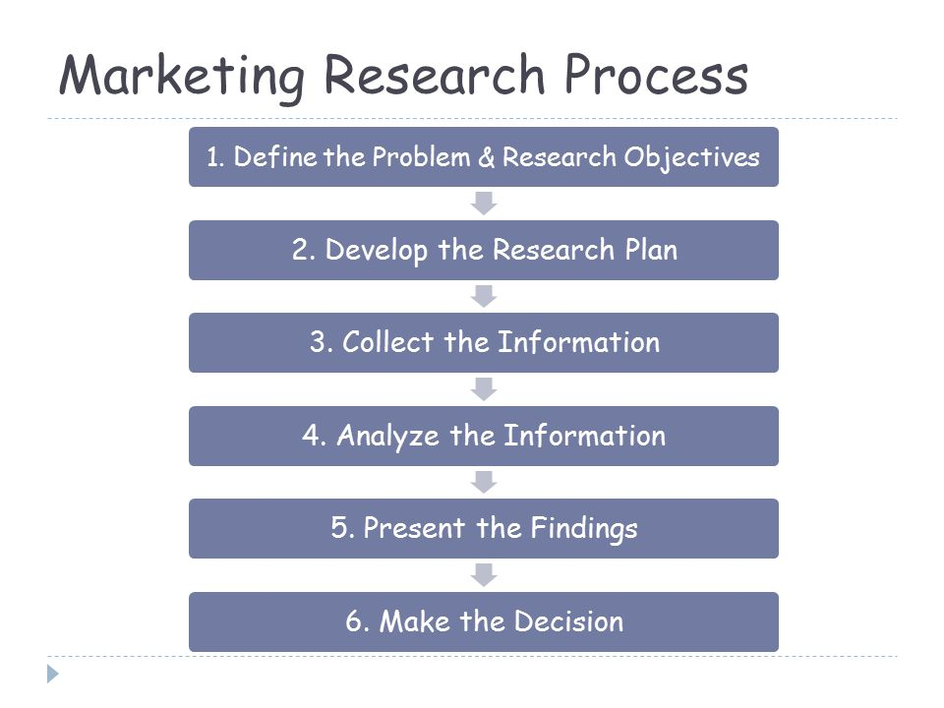
Marketing Research

Slide 22
Marketing information system
A marketing information system (MIS) is a management information system (MIS) designed to support marketing decision making.

Slide 23
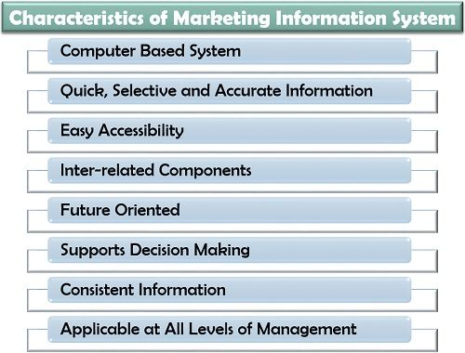

Slide 24
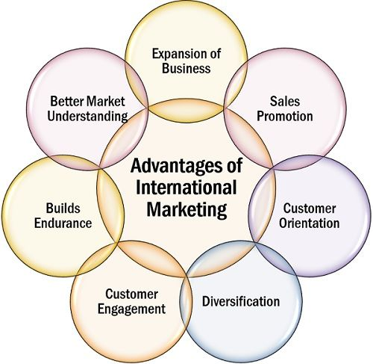
International marketing
International marketing refers to any marketing activity that occurs across borders.

Slide 25
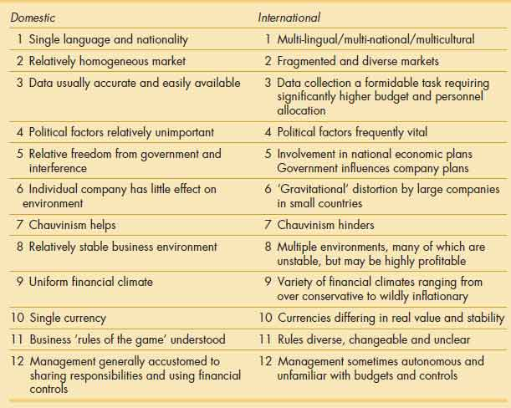
Difference between Domestic marketing and international marketing

